Slide 1
Introduction To Android
Android Mobile Development

Slide 2
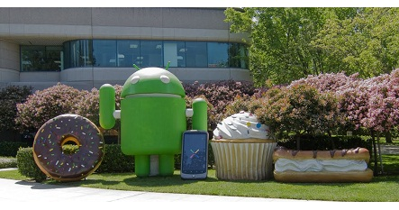
History of Android
Android Inc. founded in Palo Alto, California, United States in October 2003 by Andy Rubin, Rich Miner, Nick Sears, and Chris White

Slide 3
What Is Android?
It is a open source software platform and operating system for mobile devices
Based on the Linux kernel
Developed by Google and later the Open Handset Alliance (OHA)
Allows writing managed code in the Java language
Android has its own virtual machine, DVM (Dalvik Virtual Machine), which is used for executing the android application
Google purchased the initial developer of the software, android incorporated in 2005.

Slide 4
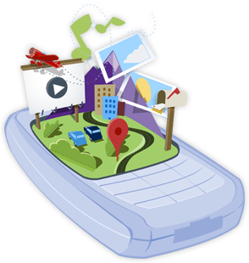
Open Handset Alliance
The open handset alliance (OHA) is a business alliance of firm to develop open standard for mobile devices.
Devoted to advancing open standards for mobile devices
Develop technologies that will significantly lower the cost of developing and distributing mobile devices and services.

Slide 5






























Open Handset Alliance

Slide 6
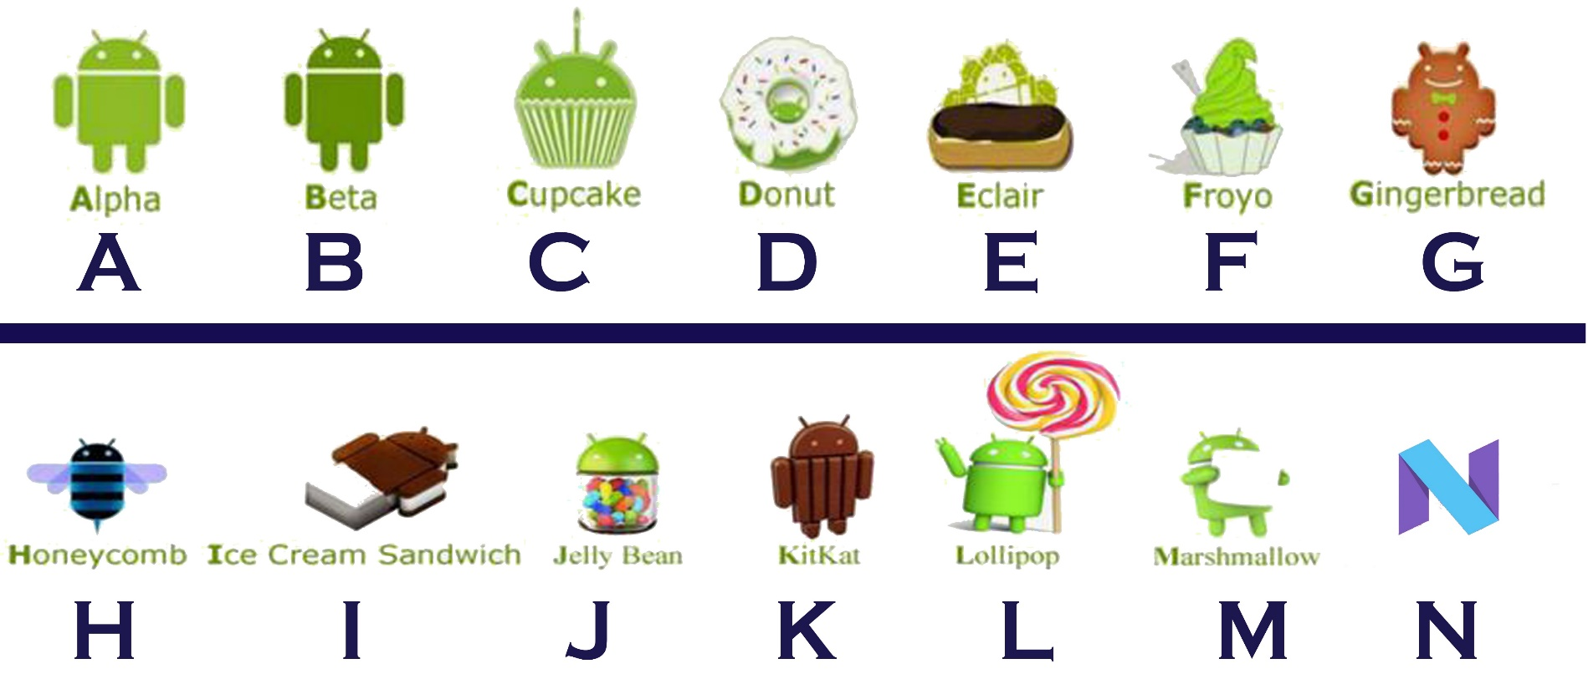
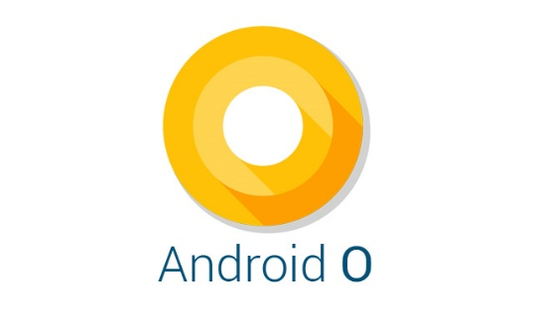
Android Version

Slide 7
Android Architecture
The software stack is split into Four Layers :
The application layer
The application framework
The libraries and runtime
The kernel

Slide 8
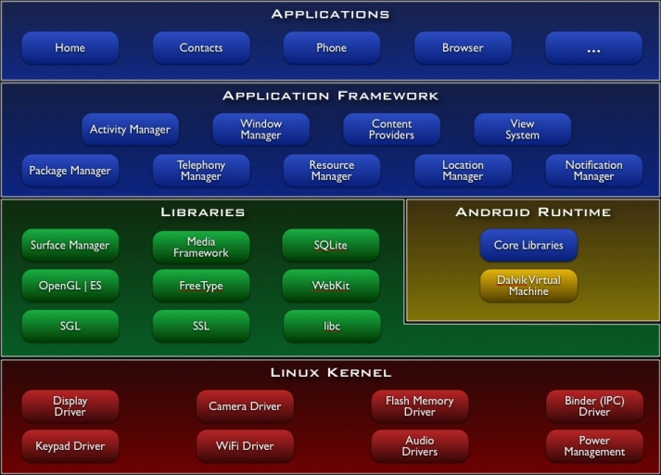

Slide 9
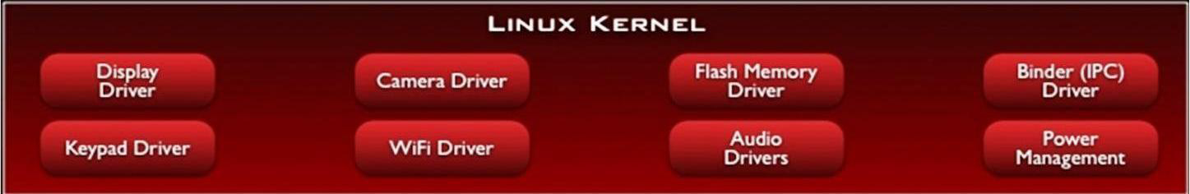
Linux Kernel
The architecture is based on the Linux2.6 kernel.
This layer is core of android architecture. It provides service like power management, memory management, security etc.
It helps in software or hardware binding for better communication.

Slide 10
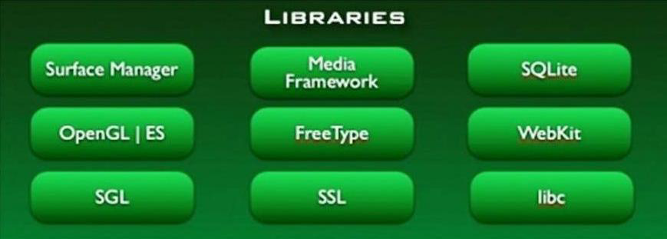
Native Libraries
Android has its own libraries, which is written in C/C++.
These libraries cannot be accessed directly. With the help of application framework, we can access these libraries.
There are many libraries like web libraries to access web browsers, libraries for android and video formats etc.

Slide 11
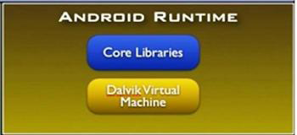
Android Runtime
The Android Runtime was designed specifically for Android to meet the needs of running in an embedded environment where you have limited battery, limited memory, limited CPU.
Dalvik is the process virtual machine in Google's android operating system.
It is the software that runs the apps on android devices.
Dalvik is thus an integral part of android ,which is typically used on mobile devices such as mobile phones and tablet computers.
Programs are commonly written in java and compiled to byte code.

Slide 12
Android Runtime
This is in blue, meaning that it's written in the Java programming language.
The core library contains all of the collection classes, utilities, IO, all the utilities and tools that you’ve come to expected to use.

Slide 13
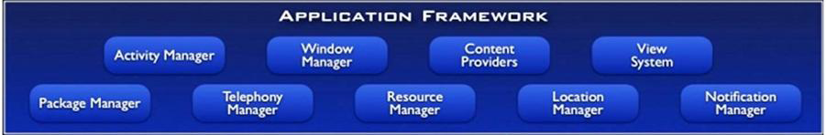
Application Framework
This is all written in a Java programming language and the application framework is the toolkit that all applications use.
These applications include the ones that come with a phone like the home applications, or the phone application.
It includes applications written by Google, and it includes apps that will be written by you.
So, all apps use the same framework and the same APIs.

Slide 14
Application Framework
These are as follows :
Activity manager : It manages the lifecycle of applications. It enable proper management of all the activities. All the activities are controlled by activity manager.
Resource manager : It provides access to non-code resources such as graphics etc.
Notification manager : It enables all applications to display custom alerts in status bar.

Slide 15
Application Framework
Location manager : It fires alerts when user enters or leaves a specified geographical location.
Package manager : It is use to retrieve the data about installed packages on device.
Window manager : It is use to create views and layouts.
Telephony manager : It is use to handle settings of network connection and all information about services on device.

Slide 16
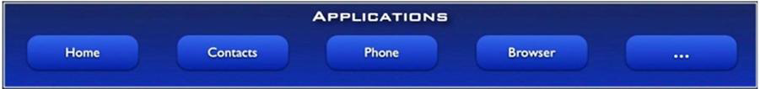
Application Layer
The final layer on top is Applications.
It includes the home application the contacts application , the browser, and apps.
It is the most upper layer in android architecture.
All the applications like camera, Google maps, browser, sms, calendars, contacts are native applications. These applications works with end user with the help of application framework to operate.

Slide 17
Security
Android is a multi-process system, in which each application (and parts of the system) runs in its own process.
Most security between applications and the system is enforced at the process level through standard Linux facilities, such as user and group IDs that are assigned to applications.
Android is designed having multi layer security which provides flexibility for this platform. When attackers attempt attack on device, android platform help to reduce the portability of the attack.

Slide 18
Android Features
Background Wi-Fi location still runs even when Wi-Fi is turned off
Developer logging and analyzing enhancements
It is optimized for mobile devices.
It enables reuse and replacement of components.
Java support, media support, multi touch, video calling, multi tasking, voice based features, screen capture, camera, bluetooth, gps, compass and accelerometer, etc

Slide 19
Advantages
The ability for anyone to customize the Google Android platform
It gives you better notification.
It lets you choose your hardware.
It has better app market (over 3 mil apps as per June 2017)
A more mature platform
With the support of many applications, the user can change the screen display.
With Google chrome you can open many window at once.
Supports all Google services

Slide 20
Disadvatages
Android Market is less control of the manager, sometimes there are malware.
Wasteful Batteries, This is because the OS is a lot of "process" in the background causing the battery quickly drains.
Sometimes slow device company issued an official version of Android your own
Extremely inconsistence in design among apps
Very unstable and often hang or crash

